Slide 1
CS 180 Intro to Data Science
Introduction & Course Overview

Slide 2
Names to Know
Tim Kapp “Tim” | “TJ” | “Professor” | “Oh Captain My Captain”
tkapp@byu.edu
TMCB 2254
Office Hours: TBD
Teaching Assistants (WVB 1151):
Kayla Ou
Toby Alley
Spencer Hales
Spencer Marshall
Michael Jensen
Patrick Wilmot
Office Hours: Posted on Syllabus

Slide 3

Tim Kapp
Cinco.ai – CEO & AI Architect
University of Utah – Adjunct Professor, AI & ML
U.N. AI for Good – Chair, Silicon Valley Innovation Factory
U.S. National AI & Cybersecurity ISAO – Founding Member
Tortora Brayda Institute for AI & Cybersecurity – Fellow
Gerald Huff Fund for Humanity – Board Member
Keynote Speaker – AI Strategy, Post AI-Economics, The Future of Work
Sample Clients: SEACEN, GoodRx, Adobe, Disney, Vatican, M1, GoDaddy, Blizzard Entertainment, Visa, ZEO Energy, InterContinental Hotels Group, Macmillan
Notes:
Hit “we don’t have all the answers” hard. I spend my day and the frustrating intersection better theory, research, and implementation.and between economics and ethics/social issues and pragmatic development.

Slide 4




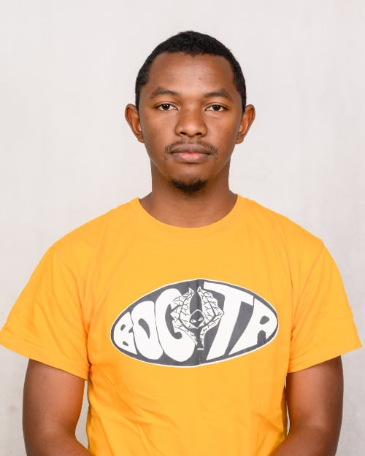











My Team - France, Madagascar, Romania, US

Slide 5
What is Data Science?
Data Science:
Scope: focuses on data as a whole, including data collection, processing, analysis, storage, and management.
End Goals: Primarily concerned with extracting knowledge and actionable insights from data.
Techniques: Uses data collection, data cleaning, data transformation, statistical analysis, data visualization, data management and data engineering tools.
Artificial Intelligence
Visualization
Data Analysis
Machine Learning
Streaming
Data
Statistics
Deep Learning
Data Science
Large-Scale
Data Collection
Generative AI
DBMS
Data Engineering

Slide 6
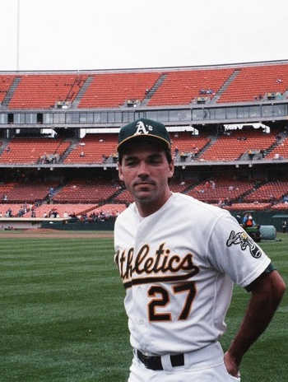


The art of winning an unfair game
A much better definition of data science & AI!
Notes:
From 1984 to 1989 Billy Beane played in MLB as an outfielder for the New York Mets, Minnesota Twins, Detroit Tigers, and Oakland Athletics. A first-round pick in the MLB draft by the Mets, Beane failed to meet the expectations of scouts, who projected him as a star. He joined the Athletics' front office as a scout in 1990, was named general manager after the 1997 season, and was promoted to executive vice president after the 2015 season. Beane has applied statistical analysis (known as sabermetrics) to baseball, which has led teams to reconsider how they evaluate players. in the 2006 MLB season, the Athletics ranked 24th of 30 major league teams in player salaries but had the 5th-best regular-season record. The Athletics reach the playoffs in four consecutive years from 2000 through 2003. First team in 100 years to win 20 consecutive games. Turned down $12.5M offer from the Boston Red Sox and accepted part ownership of the A’s. Currently EVP of baseball operations.

Slide 7
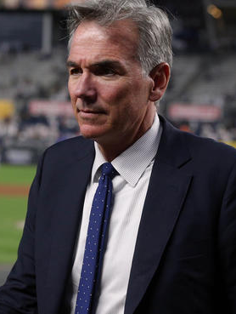
Billy Beane
A first-round pick in the MLB draft by the Mets
1984 to 1989 he played in MLB as an outfielder for the New York Mets, Minnesota Twins, Detroit Tigers, and Oakland Athletics but failed to ever meet the expectations of scouts.
He joined the Athletics' as a scout in 1990 just as budgets were being slashed.
Bean applied statistical analysis (sabermetrics) to baseball in order to build a team of amazing players that everyone else had overlooked.
In the 2006 MLB season, the Athletics ranked 24th of 30 major league teams in player salaries but had the 5th-best regular-season record.
The A’s reach the playoffs in 4 consecutive years (2000 - 2003)
First team in 100 years to win 20 consecutive games.

Slide 8


How I bought my first house and won a trip to Hawaii with predictive analytics

Slide 9

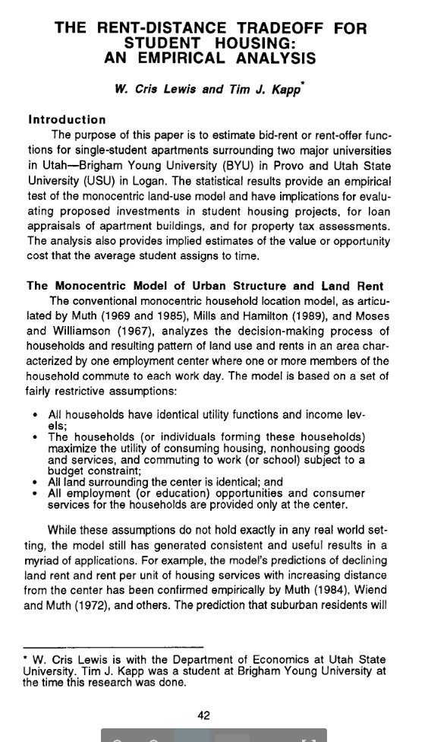
“The Rent Distance Tradeoff for Student Housing”
Rent does correlate to distance from important “hot spots”
Small things can make a big difference - i.e. garbage disposal
You often discover the unexpected - i.e. pools have negative value
Notes:
Published in Journal of Regional Analysis and Policy: https://jrap.scholasticahq.com/article/9045-the-rent-distance-tradeoff-for-student-housing-an-empirical-analysis

Slide 10
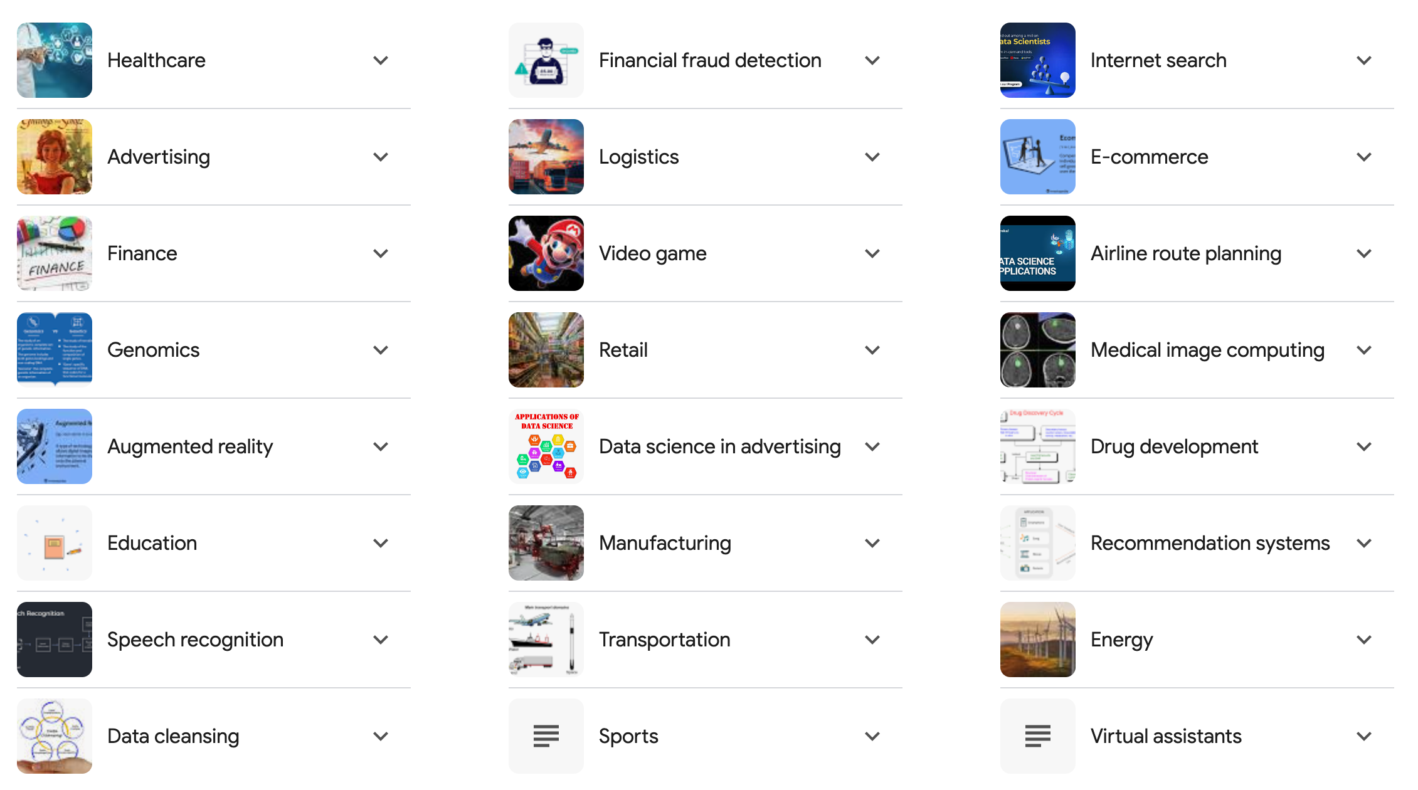
Why Data Science?
Notes:
Today, Data Science impacts almost every aspect of our lives. Applications have made breakthrough in many areas from Healthcare to Speech Recognition, Internet Search, Genomics, and everywhere in between. What DS applications are you currently using every day?

Slide 11

Tech stuff we’ll learn
Define Problem
The Data Science Lifecycle process
Using Python for data science (Numpy, Pandas, Matplotlib, Scikit-Learn, and more)
How to prepare data for analysis
How to explore data for insights
Data Visualization (Python and Tableau)
Data Management (SQL)
Machine Learning basic algorithms
Use of GenAI tools for language-based problems
Manage-Measure
Acquire Data
Data Platform
Deploy Model
Prepare Data
Build Model

Slide 12


Gen AI Applications
Code
Video
Text
Image
Audio/Music

Slide 13
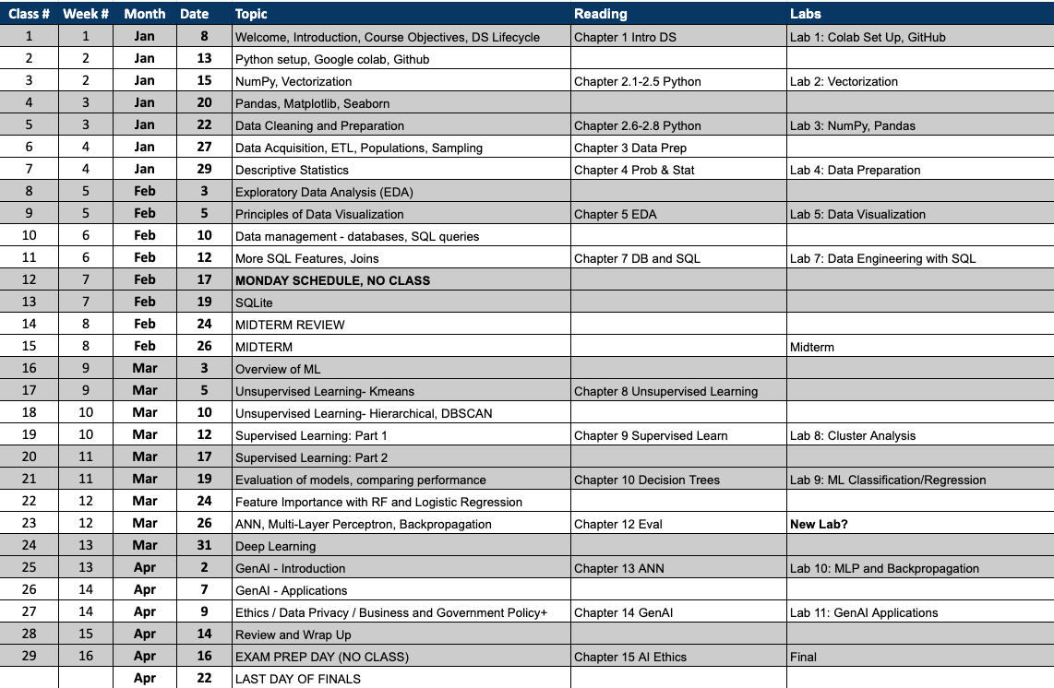
We will cover a Lot this Semester!

Slide 14
Course Goals
Learn new data science and AI tools quickly in a fast-changing technical world
Use data, machine learning, and AI to extract real insight from messy, real-world data
Work effectively with AI systems, knowing when to trust them—and when not to
Communicate insights clearly through visualization, dashboards, and data storytelling
Think critically about results, assumptions, bias, and uncertainty
DO GOOD THINGS…Apply data science and AI for real-world impact and social good

Slide 15
We are a Learning Community
What this means
We learn faster and deeper together than alone
Everyone contributes: questions, ideas, mistakes, and insights
How we do it
Say your name for the first few classes at least
Introduce yourself to the people around you—every class
Talk, compare approaches, challenge ideas, help each other think
Why it matters
Better understanding and performance
Stronger professional and social connections
A real sense of belonging
And honestly… it’s more fun

Slide 16
AI “Policy”
Generative AI in This Course
GenAI tools can be powerful learning assistants
Misuse turns them into a crutch and weakens understanding
Our goal is deep skills, not just correct answers
Use AI to: clarify concepts, look up syntax, understand examples
Don’t use AI to: solve assignments end-to-end or replace your thinking
We trust you to follow this policy. We won’t actively police AI use—but if misuse is obvious, we’ll address it.
Some parts of the midterm and final will be AI-free by design.

Slide 17
Upcoming Assignments
Sign up for zyBook
How? Go to the first reading assignment in Canvas and click “Load Chapter 1 Reading…”
This will initiate the process of buying the zyBook. You should not have to do this again.
Reading Assignment: Chapter 1
Points automatically accrue as you do the activities in the book.
Data Science Lab 1: Intro to Colab
Set up a Python Development Environment.
Programming assignments will be turned in via Google Colab notebooks. However, if you are planning a career requiring programming, I recommend using a professional IDE, such as VS Code. If needed, we’ll go through the setup quickly next week.
Getting Set Up “Assignment”
This will help you (and me) hit the ground running!

Slide 18
Why data science and AI?

Slide 19

What do you see?
A metaphor for data science
The Snow Leopard Represents:
Signal hidden in noise
Rare but important patterns
Outliers that matter
Ground truth you miss if you don’t look carefully
The Cliff Represents:
Raw data — messy, unstructured, overwhelming
Where most people stop looking
Why It’s Hard to See:
Your brain optimizes for speed, not correctness
“The hardest part of data science isn’t computing.It’s knowing what you’re looking for — and what you might be missing.
“Most failures in data science aren’t wrong answers. They’re unseen answers.”
And because…
Notes:
The image is a famous optical illusion photograph by Saurabh Desai, featuring a well-camouflaged snow leopard on a cliff face.
The snow leopard is known as the "ghost of the mountains" due to its elusive nature and expert camouflage, blending seamlessly with the rocky, snowy environment.
In this specific image, the leopard is looking directly at the camera, situated near the top center of the image, just below the patch of snow.
Its tawny and white coat with dark rosettes makes it difficult to spot initially.
The thick, long tail, which helps with balance and stores fat, is also visible.

Slide 20
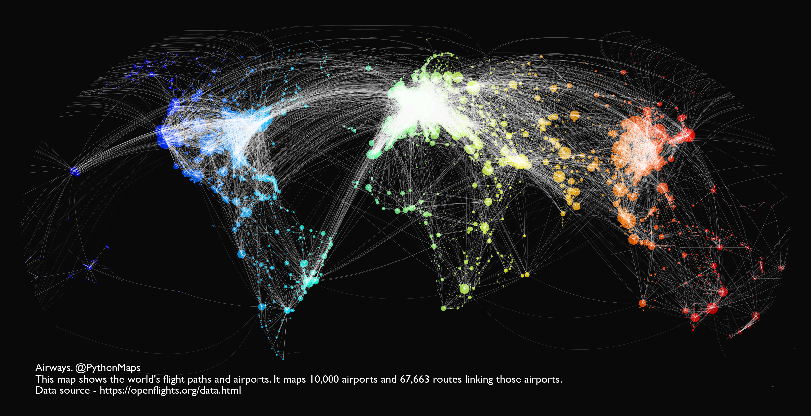
Parts of the World are too Complex for Humans!

Slide 21
Interesting applications of data science and things to watch out for

Slide 22
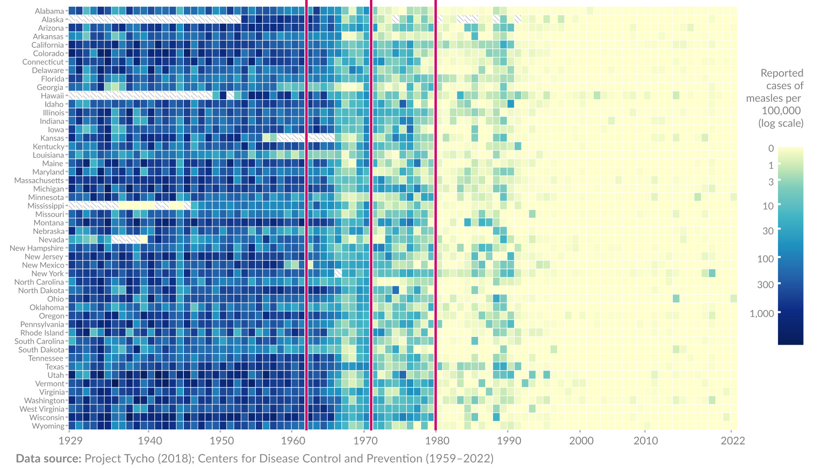
1971: Measles-mumps-rubella vaccine developed
1963: Measles vaccine developed
1980: Mandatory for kindergarteners to be vaccinated
US States
Notes:
U.S. Trends (2020–2025)
Here’s a year-by-year breakdown of reported U.S. measles cases:
2020: 13 cases
2021: 49 cases
2022: 121 cases
2023: 59 cases
2024: 285 cases
2025 (to date): Approximately 1,288 cases

Slide 23
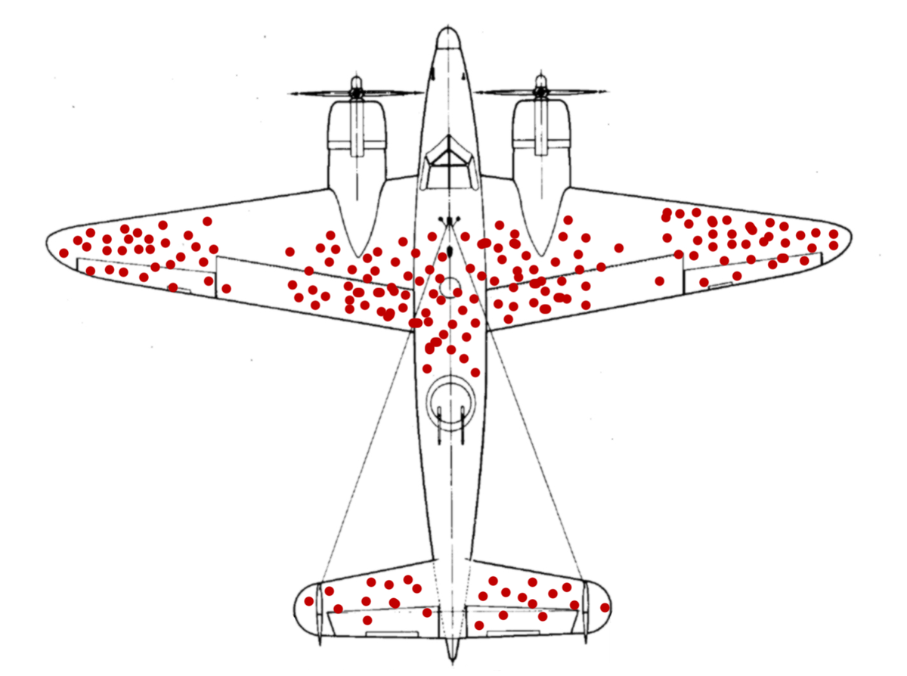
Notes:
Back during World War II, the RAF lost a lot of planes to German anti-aircraft fire. So they decided to armor them up. But where to put the armor? The obvious answer was to look at planes that returned from missions, count up all the bullet holes in various places, and then put extra armor in the areas that attracted the most fire.
Obvious but wrong. As Hungarian-born mathematician Abraham Wald explained at the time, if a plane makes it back safely even though it has, say, a bunch of bullet holes in its wings, it means that bullet holes in the wings aren’t very dangerous. What you really want to do is armor up the areas that, on average, don’t have any bullet holes. Why? Because planes with bullet holes in those places never made it back. That’s why you don’t see any bullet holes there on the ones that do return. Clever!

Slide 24
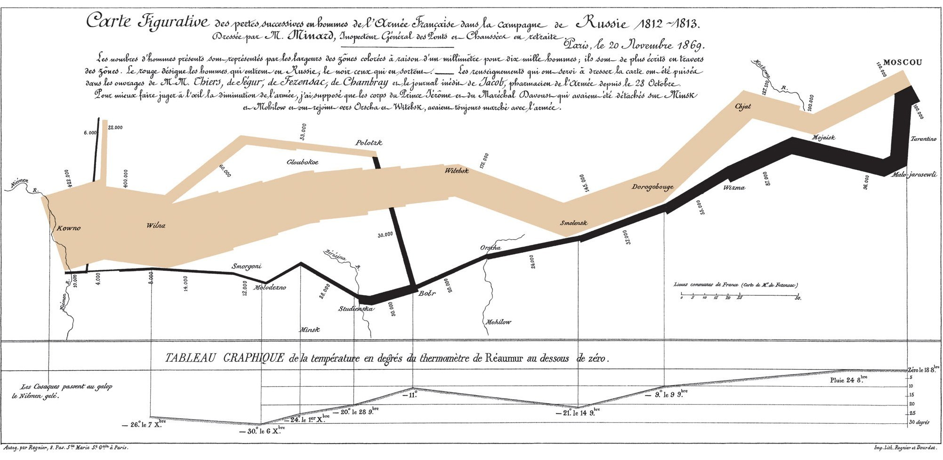
Napoleon’s Disastrous invasion of Russia in 1812
Notes:
The orange and black columns crossing the map show the French Grande Armée on its march to and from Moscow. The width of the column shows the size of the army – ever-shrinking as thousands of Napoleon’s soldiers died of disease, cold, starvation and Russian attacks. This image brilliantly displays the devastation of Napoleon’s army over the winter of 1812-13. It has been called “the best statistical graph ever drawn”.
Napoleon invaded Russia in June 1812, marching his army of 680,000 soldiers across the river Neman. He hoped to force Tsar Alexander I of Russia to stop trading with Britain, and finally force the British to end their long wars against France. Instead, the Russian army retreated, refusing to give Napoleon the decisive battle he fought. The French forces marched on Moscow, but Cossack troops burned the countryside ahead of them, cutting off all sources of food and shelter. The campaign was a disaster, with 380,000 troops of the Grand Armee being killed. With his largest army shattered, Napoleon was forced to retreat across Europe, eventually being defeated by the Allied Sixth Coalition, and sent into exile on the island of Elba.
The black line straggling back from Moscow shows this terrible rate of casualties, and the temperature scale at the bottom of the image charts the freezing weather conditions of the Russian winter. In all, this image displays six types of data in two dimensions: the number of Napoleon’s troops; the distance travelled; temperature; latitude and longitude; direction of travel; and location relative to specific dates. The arrows coming off the main bar also let Minard show where smaller forces left the main army and later rejoined it.
Charles Minard was 31 at the time of the Russian campaign. He was an engineer, creating harbors and canals for the French state. In later life, he became fascinated by maps and charts to explain complex situations. He was willing to bend geography to better express the essentials of his data. Minard himself admitted:
“The aim of my carte figurative is less to express statistical results, better done by numbers, than to convey promptly to the eye the relation not given quickly by numbers requiring mental calculation.”
This chart, seen as his finest achievement, was created in 1869, when Minard was over 80 years old.

Slide 25
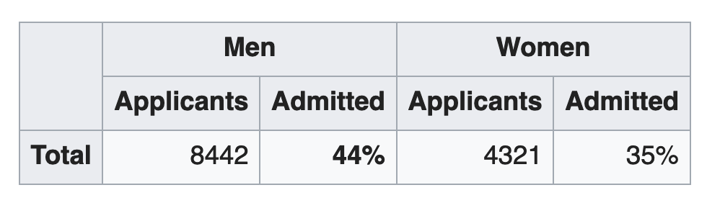
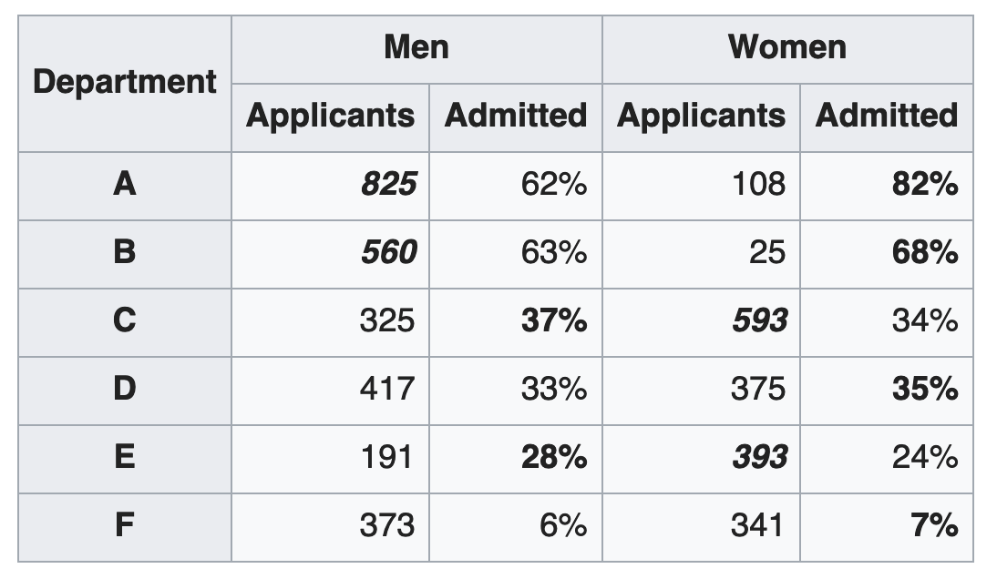
Gender Bias at Berkley (1973)
Are men applying to Berkeley more likely to get in than women?
Departments have different acceptance rates,
More women applied to departments with lower acceptance rates
Notes:
Was Berkley biased in their enrollments?
What would be a better question?

Slide 26
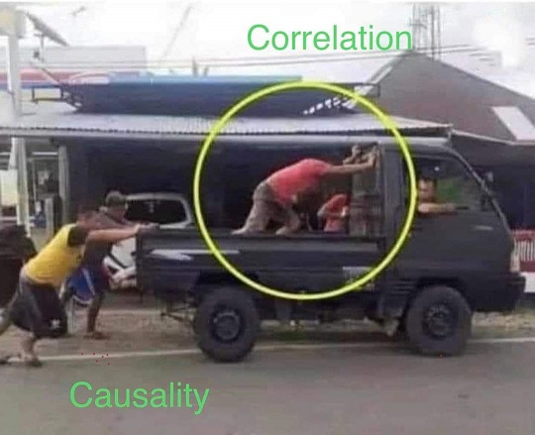
Spurious Correlations
Notes:
Correlation r = 0.9313793 (Pearson correlation coefficient) Correlation is a measure of how much the variables move together. If it is 0.99, when one goes up the other goes up. If it is 0.02, the connection is very weak or non-existent. If it is -0.99, then when one goes up the other goes down. If it is 1.00, you probably messed up your correlation function. r² = 0.8674674 (Coefficient of determination) This means 86.7% of the change in the one variable (i.e., UFO sightings in South Carolina) is predictable based on the change in the other (i.e., Popularity of the first name Annabelle) over the 47 years from 1975 through 2021. p < 0.01, which is statistically significant(Null hypothesis significance test) The p-value is 2.3E-21.^{Show} The p-value is a measure of how probable it is that we would randomly find a result this extreme.^{Note} On average, you will find a correaltion as strong as 0.93 in 2.3E-19% of random cases. Said differently, if you correlated 441,924,063,127,615,045,632 random variables^{Note} with the same 46 degrees of freedom, ^{Note} you would randomly expect to find a correlation as strong as this one. [ 0.88, 0.96 ] 95% correlation confidence interval (using the Fisher z-transformation) Read more about the confidence interval

Slide 27
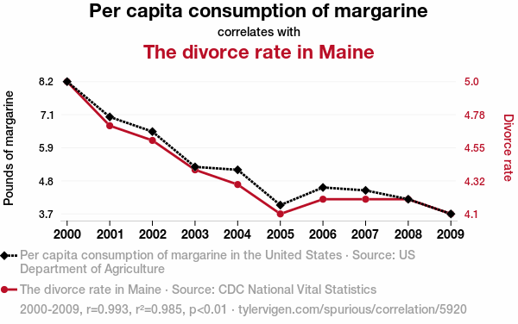
Spurious Correlations
Notes:
Correlation r = 0.9925585 (Pearson correlation coefficient) Correlation is a measure of how much the variables move together. If it is 0.99, when one goes up the other goes up. If it is 0.02, the connection is very weak or non-existent. If it is -0.99, then when one goes up the other goes down. If it is 1.00, you probably messed up your correlation function. r² = 0.9851723 (Coefficient of determination) This means 98.5% of the change in the one variable (i.e., The divorce rate in Maine) is predictable based on the change in the other (i.e., Per capita consumption of margarine) over the 10 years from 2000 through 2009. p < 0.01, which is statistically significant(Null hypothesis significance test) The p-value is 1.3E-8.^{Show} The p-value is a measure of how probable it is that we would randomly find a result this extreme.^{Note} On average, you will find a correaltion as strong as 0.99 in 1.3E-6% of random cases. Said differently, if you correlated 75,206,215 random variables^{Note} with the same 9 degrees of freedom, ^{Note} you would randomly expect to find a correlation as strong as this one. [ 0.97, 1 ] 95% correlation confidence interval (using the Fisher z-transformation) Read more about the confidence interval All values for the years included above: ^{Note}2000200120022003200420052006200720082009Per capita consumption of margarine (Pounds of margarine)8.276.55.35.244.64.54.23.7The divorce rate in Maine (Divorce rate)54.74.64.44.34.14.24.24.24.1

Slide 28
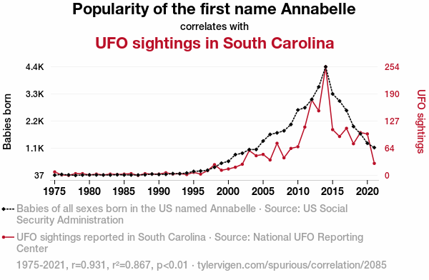
Spurious Correlations
https://www.tylervigen.com/spurious-correlations
Notes:
Correlation r = 0.9313793 (Pearson correlation coefficient) Correlation is a measure of how much the variables move together. If it is 0.99, when one goes up the other goes up. If it is 0.02, the connection is very weak or non-existent. If it is -0.99, then when one goes up the other goes down. If it is 1.00, you probably messed up your correlation function. r² = 0.8674674 (Coefficient of determination) This means 86.7% of the change in the one variable (i.e., UFO sightings in South Carolina) is predictable based on the change in the other (i.e., Popularity of the first name Annabelle) over the 47 years from 1975 through 2021. p < 0.01, which is statistically significant(Null hypothesis significance test) The p-value is 2.3E-21.^{Show} The p-value is a measure of how probable it is that we would randomly find a result this extreme.^{Note} On average, you will find a correaltion as strong as 0.93 in 2.3E-19% of random cases. Said differently, if you correlated 441,924,063,127,615,045,632 random variables^{Note} with the same 46 degrees of freedom, ^{Note} you would randomly expect to find a correlation as strong as this one. [ 0.88, 0.96 ] 95% correlation confidence interval (using the Fisher z-transformation) Read more about the confidence interval

Slide 29
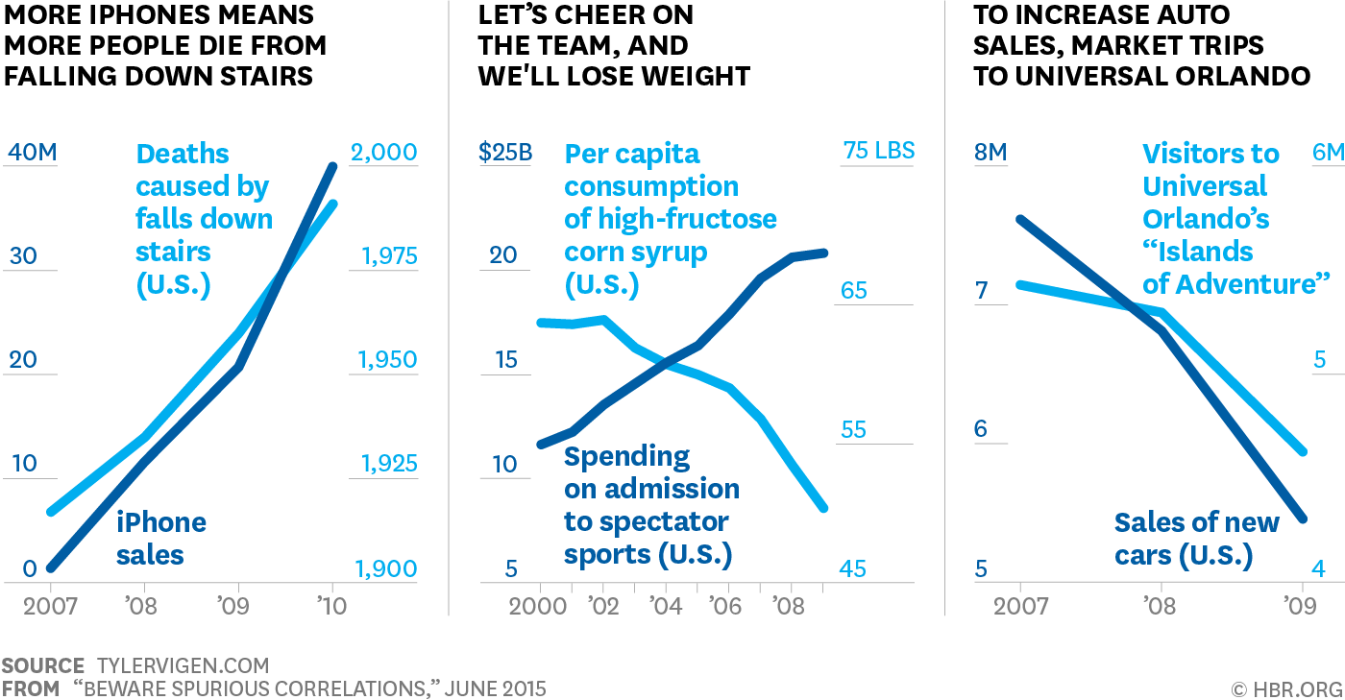
Confounding Variable Economy
Notes:
Correlation r = 0.9313793 (Pearson correlation coefficient) Correlation is a measure of how much the variables move together. If it is 0.99, when one goes up the other goes up. If it is 0.02, the connection is very weak or non-existent. If it is -0.99, then when one goes up the other goes down. If it is 1.00, you probably messed up your correlation function. r² = 0.8674674 (Coefficient of determination) This means 86.7% of the change in the one variable (i.e., UFO sightings in South Carolina) is predictable based on the change in the other (i.e., Popularity of the first name Annabelle) over the 47 years from 1975 through 2021. p < 0.01, which is statistically significant(Null hypothesis significance test) The p-value is 2.3E-21.^{Show} The p-value is a measure of how probable it is that we would randomly find a result this extreme.^{Note} On average, you will find a correaltion as strong as 0.93 in 2.3E-19% of random cases. Said differently, if you correlated 441,924,063,127,615,045,632 random variables^{Note} with the same 46 degrees of freedom, ^{Note} you would randomly expect to find a correlation as strong as this one. [ 0.88, 0.96 ] 95% correlation confidence interval (using the Fisher z-transformation) Read more about the confidence interval

Slide 30
What’s the cost of bad data science?

Slide 31
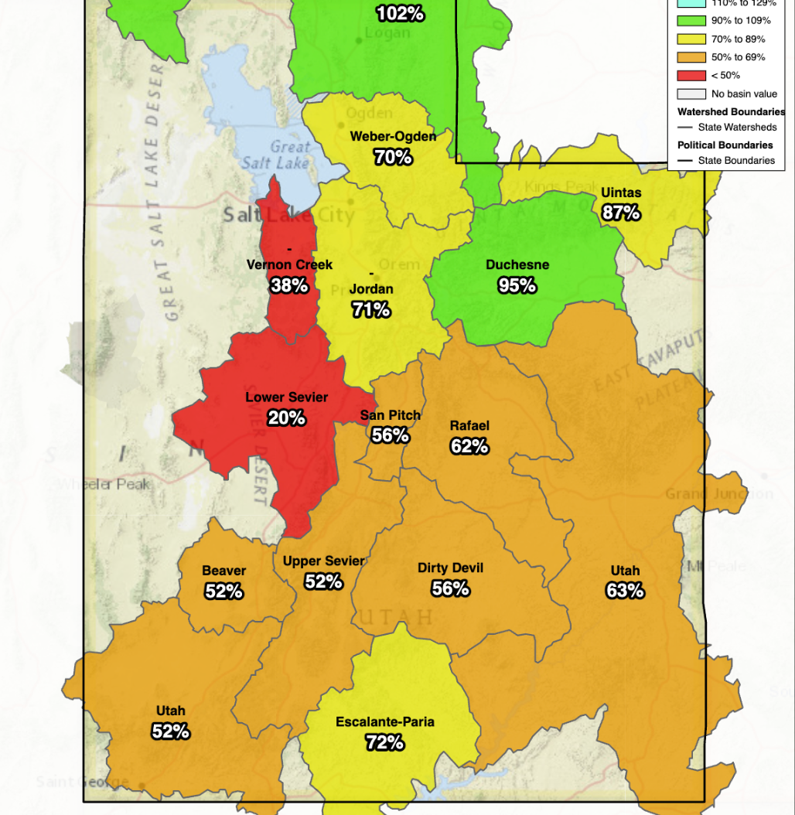
Crying “Wolf”
Utah Snow Pack
Even when the data is correct, you have to worry about interpretation.
At the end of a snow season, this chart would be disastrous. At the beginning it’s “meh”. Why?
There are many systems that act like expiring “options” that behave this way.

Slide 32
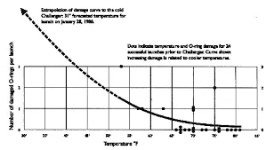
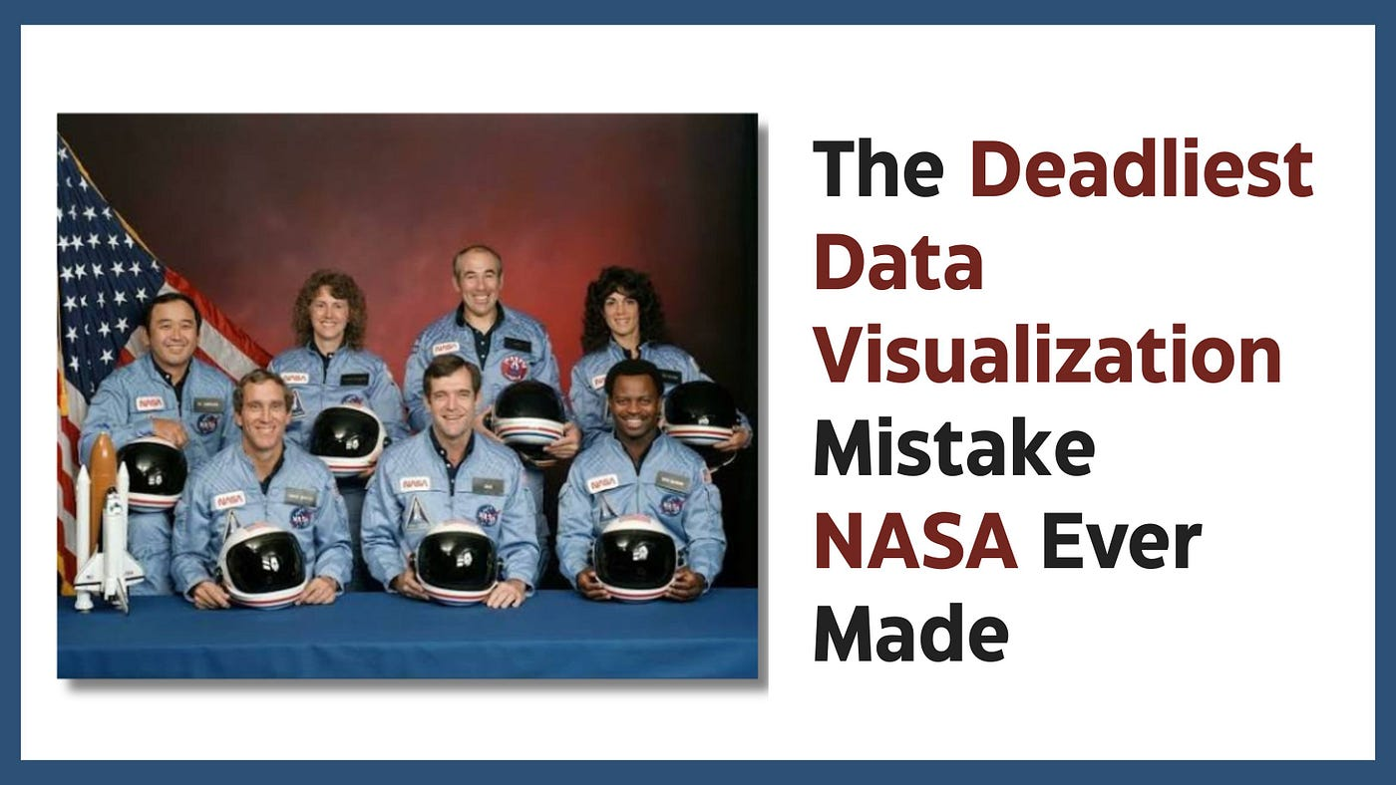
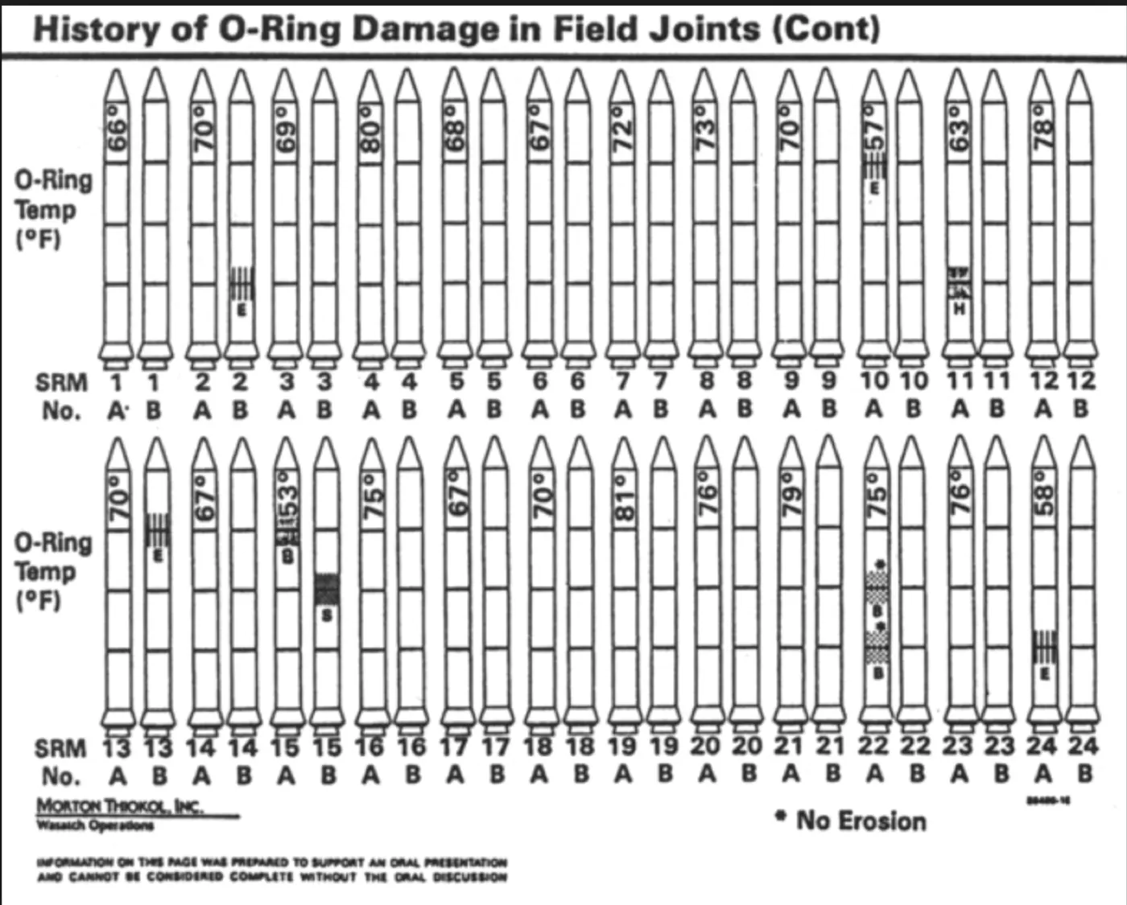
Bad data costs lives
The Space Shuttle
Rubber becomes less flexible as temperature drops. O-rings might not seal properly during ignition,
At launch time, the temperature at the Kennedy Space Center was 36 degrees Fahrenheit. This was 15 degrees colder than any prior Space Shuttle launch.
Before the launch, engineers attempted to persuade NASA management to delay the mission. They brought data from earlier shuttle flights showing instances of O-ring erosion.
Charts shown to decision-makers listed launches in tabular form, documenting which O-rings had erosion and which did not. What the charts failed to do was plot O-ring damage against temperature in a clear, visual manner.
Launches with no O-ring damage were largely excluded from the analysis. This omission distorted the picture.
Notes:
https://medium.com/@abi12subramaniam/the-challenger-disaster-the-most-expensive-data-visualization-mistake-in-history-a3bb23c1088d

Slide 33
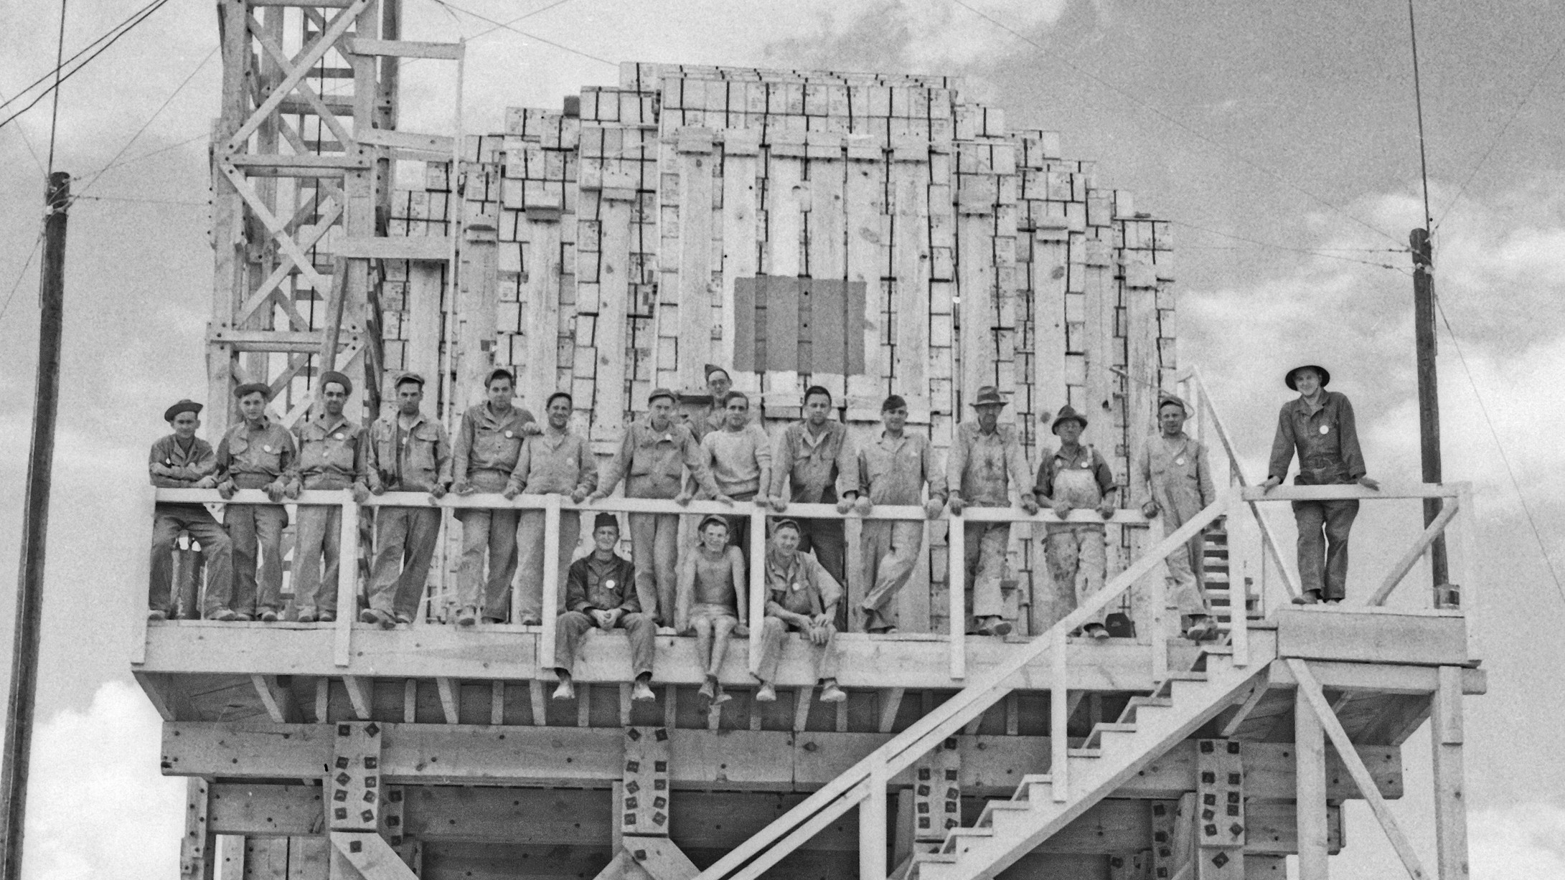

Notes:
100 tons of TNT laced with small amounts of radioactive matter, was designed to calibrate the instruments and help build a model for the dispersion of radioactive material. The serious working estimate for the bomb itself was was maybe 2-10 kilotons of TNT. The actual bomb was 20 kilotons. 2-10x larger than the working estimate.

Slide 34

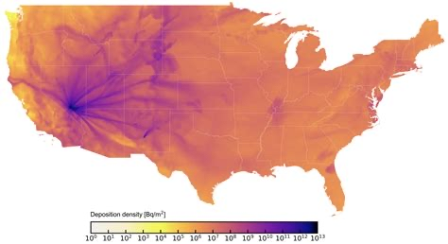
The Fallout
Trinity bomb was 200x larger than the TNT test.
4-10x larger than consensus estimate (~21 kilotons)
Land based testing: cancer-related deaths near blast zones ~ 10-24
Bomb tests pushed radio active material into the stratosphere and jet stream
Between 17k - 340k excess deaths (US only) from cancer nationwide
Jet Stream
Nuclear Test → Fallout on Grass → Cows Eat Grass → Milk → People → Thyroid & Cancer Risk

Slide 35
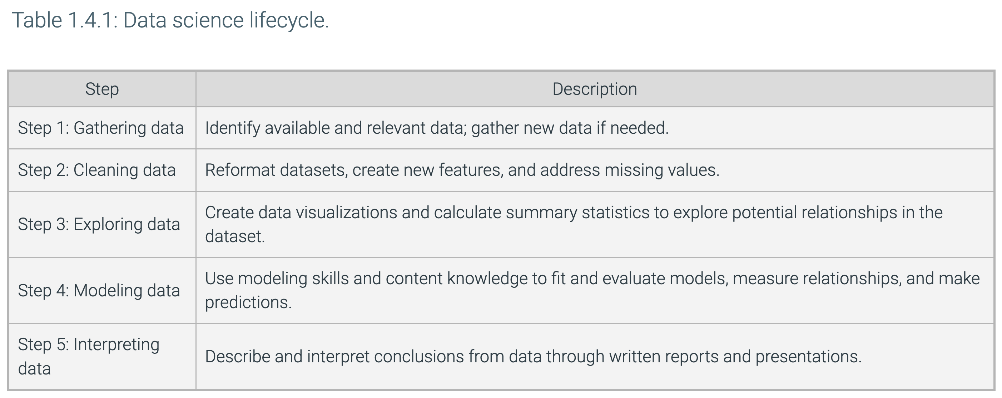
zyBook Data Science Lifecycle for Data Analysis

Slide 36
How would you approach a data-driven problem?

Slide 37

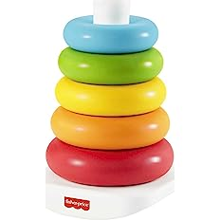
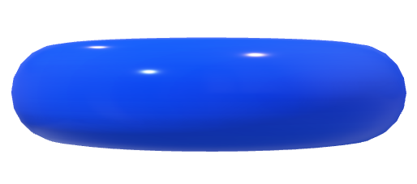
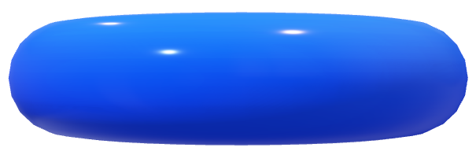
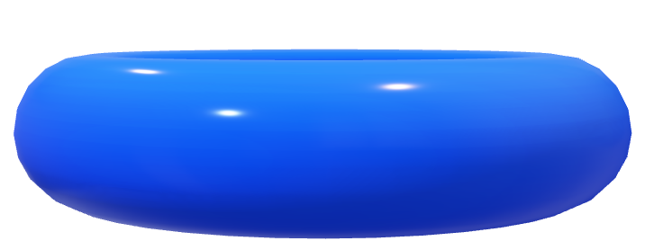
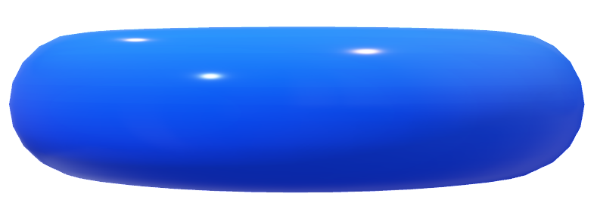
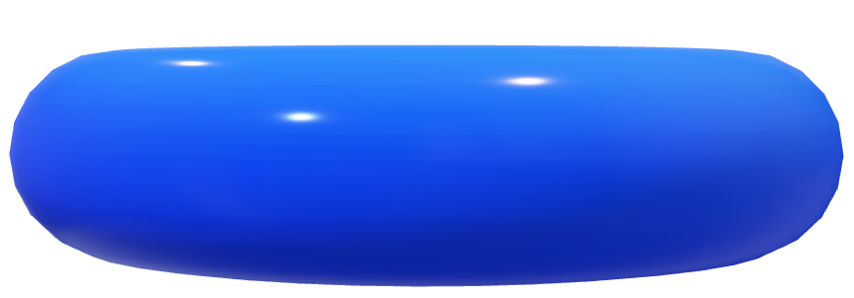
The 6S5P Data Science Lifecycle for Taking Action with Data
Define Problem
DataOps
Manage-Measure
Acquire Data
Production
Pilot
Data Platform
Prototype
Proof-of-Value
Deploy Model
Prepare Data
Proof-of-Concept
Data Management Platform
Inspiration for 6S5P process
Build Model
Notes:
The Six Stage Five Phase Lifecycle:
I was struggling to create a visual analogy for explaining the Data Science Lifecycle. Then I saw my 9 month old grandson playing with his donut shaped stacking toys.
Bingo! It was the perfect analogy for illustrating the 3-dimenstional nature of the DS lifecycle that has both stages and phases.
The Data Science lifecycle is similar in many ways to the SDLC but also subtly different. What differences to you see? Why do we have these differences for Data Science applications?
This structure is unique to my experience. By having both phases and stages we can better capture the evolution of applications as they move from initial concepts to full production.

Slide 38
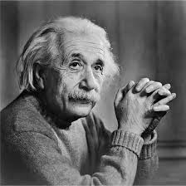
1. Define the (REAL) Problem
What is the core problem?
What processes, systems, orgs are affected?
If solved, what is business value?
How can problem be scoped?
How is value measured?
Characterize problem domain
Is this a data-driven problem?
What data is needed? (prelim)
“
If I had an hour to solve a problem I'd spend 55 minutes
thinking about the problem and 5 minutes thinking about solutions.
“
Albert Einstein
Notes:
Some times we jump into working on a solution before carefully determining the actual problem. The real problem may be something completely different than what is seen at first glance.
For example, while working for AT&T on customer churn we thought that if we just had a model to predict who would churn, then we could use that model to make significant impacts in churn reduction. But what was the real problem?
If we could predict someone would churn, we still might not improve retention, why?
Some of the subscribers were going to churn anyway, no matter what we did. Others were going to stay, no matter what we did. Instead of predicting churners, we actually needed to segment out those that were either out the door or loyalists. Also, there was a segment we called “let sleeping dogs lie.” That is, any contact could cause them to wake up and churn. So we focused on modeling which customers that were predicted to churn would change their minds based on the marketing treatment (e.g., free phone, additional data, etc.). We needed to know of those likely to churn, who would positively respond to a given marketing treatment. That was the real problem. Also, we had the constraint that the marketing treatment needed to be financially justified.

Slide 39
2. Identify and Acquire the Data
Source Data
Detailed data needed to address problem
Where is data?
Minimum data needed for MVP*
Strategy to collect all data
Join data sources
ETL# tools, processes, execution
Result: Raw Analytic Data Set or View
Run | Type | Accuracy | Precision | Sensitivity | Acc+Sen
1 | Binary | 91.00% | 47.00% | 0.25% | 94.00%
2 | Binary | 78.00% | 22.00% | 1.00% | 94.40%
3 | Binary | 51.00% | 43.65% | 0.15% | 94.04%
4 | Binary | 91.00% | None | 0.00% | 94.00%
5 | Binary | 91.00% | None | 0.00% | 94.00%
6 | Binary | 92.00% | None | 0.00% | #VALUE!
7 | Binary | 91.00% | None | 0.00% | 82.40%
8 | Binary | 91.00% | None | 0.00% | 82.42%
9 | Binary | 91.00% | None | 0.00% | 84.52%
10 | Binary | 91.00% | 25.00% | 0.61% | 82.78%
11 | Binary | 77.00% | 20.37% | 64.56% | 84.57%
Billing Table
Run | Type | Accuracy | Precision | Sensitivity | Acc+Sen
1 | Binary | 91.00% | 47.00% | 0.25% | 94.00%
2 | Binary | 78.00% | 22.00% | 1.00% | 94.40%
3 | Binary | 51.00% | 43.65% | 0.15% | 94.04%
4 | Binary | 91.00% | None | 0.00% | 94.00%
5 | Binary | 91.00% | None | 0.00% | 94.00%
6 | Binary | 92.00% | None | 0.00% | #VALUE!
7 | Binary | 91.00% | None | 0.00% | 82.40%
8 | Binary | 91.00% | None | 0.00% | 82.42%
9 | Binary | 91.00% | None | 0.00% | 84.52%
10 | Binary | 91.00% | 25.00% | 0.61% | 82.78%
11 | Binary | 77.00% | 20.37% | 64.56% | 84.57%
Call Center Table
Run | Type | Accuracy | Precision | Sensitivity | Acc+Sen
1 | Binary | 91.00% | 47.00% | 0.25% | 94.00%
2 | Binary | 78.00% | 22.00% | 1.00% | 94.40%
3 | Binary | 51.00% | 43.65% | 0.15% | 94.04%
4 | Binary | 91.00% | None | 0.00% | 94.00%
5 | Binary | 91.00% | None | 0.00% | 94.00%
6 | Binary | 92.00% | None | 0.00% | #VALUE!
7 | Binary | 91.00% | None | 0.00% | 82.40%
8 | Binary | 91.00% | None | 0.00% | 82.42%
9 | Binary | 91.00% | None | 0.00% | 84.52%
10 | Binary | 91.00% | 25.00% | 0.61% | 82.78%
11 | Binary | 77.00% | 20.37% | 64.56% | 84.57%
Customer Profile Table
Web Activity Table
Run | Type | Accuracy | Precision | Sensitivity | Acc+Sen
1 | Binary | 91.00% | 47.00% | 0.25% | 94.00%
2 | Binary | 78.00% | 22.00% | 1.00% | 94.40%
3 | Binary | 51.00% | 43.65% | 0.15% | 94.04%
4 | Binary | 91.00% | None | 0.00% | 94.00%
5 | Binary | 91.00% | None | 0.00% | 94.00%
6 | Binary | 92.00% | None | 0.00% | #VALUE!
7 | Binary | 91.00% | None | 0.00% | 82.40%
8 | Binary | 91.00% | None | 0.00% | 82.42%
9 | Binary | 91.00% | None | 0.00% | 84.52%
10 | Binary | 91.00% | 25.00% | 0.61% | 82.78%
11 | Binary | 77.00% | 20.37% | 64.56% | 84.57%
Raw ADS
Potential variables required to solve business problem
Very wide data set
Derived, Joined and Transformed
A | B | C | D | E | F | G | H | I | J | K | L | M
Acct ID | Att 1 | Att 2 | Number | Add | Age | SSN | SSN | SSN | SSN | SSN | SSN | SSN
12345 | ajklfff | 33efjgkl | 33efjgk | 33efjgkl | 33efjgkl | 33efjgkl | 33efjg | 33efj | 33ef | 33ef | 33ef | 33ef
12346 | ajklfff | 33efjgkl | 33efjgk | 33efjgkl | 33efjgkl | 33efjgkl | fjfkl | 123 | kjj | 666 | 4236 | 4425
12347 | ajklfff | 33efjgkl | 33efjgk | 33efjgkl | 33efjgkl | 33efjgkl | fjfkl | 123 | kjj | 666 | 4236 | 4425
12348 | ajklfff | 33efjgkl | 33efjgk | 33efjgkl | 33efjgkl | 33efjgkl | fjfkl | 123 | kjj | 666 | 4236 | 4425
12349 | ajklfff | 33efjgkl | efjgklk | 33efjgkl | 33efjgkl | 33efjgkl | fjfkl | 123 | kjj | 666 | 4236 | 4425
12350 | ajklfff | 33efjgkl | 33efklk | 33efjgkl | 33efjgkl | 33efjgkl | fjfkl | 123 | kjj | 666 | 4236 | 4425
12351 | ajklfff | 33efjgkl | #%$GG | 33efjgkl | 33efjgkl | 33efjgkl | fjfkl | 123 | kjj | 666 | 4236 | 4425
Notes:
*Minimum Viable Product
# Extract, Transform, Load

Slide 40
3. Understand and Prepare the Data
Modeling Ready ADS
A | C | E | F | K | M
Acct ID | Att 2 | Att 31 | Age | SSN | REV
12345 | 33efjgkl | 33efjgkl | 33efjgkl | 33ef | 33ef
12346 | 33efjgkl | 33efjgkl | 33efjgkl | 666 | 4425
12347 | 33efjgkl | 33efjgkl | 33efjgkl | 666 | 4425
12348 | 33efjgkl | 33efjgkl | 33efjgkl | 666 | 4425
12349 | 33efjgkl | 33efjgkl | 33efjgkl | 666 | 4425
12350 | 33efjgkl | 33efjgkl | 33efjgkl | 666 | 4425
12351 | 33efjgkl | 33efjgkl | 33efjgkl | 666 | 4425
12345 | 33efjgkl | 33efjgkl | 33efjgkl | 33ef | 2223
12346 | 33efjgkl | 33efjgkl | 33efjgkl | 666 | 4425
12347 | 33efjgkl | 33efjgkl | 33efjgkl | 666 | 4425
12348 | 33efjgkl | 33efjgkl | 33efjgkl | 666 | 4425
12349 | 33efjgkl | 33efjgkl | 33efjgkl | 666 | 4425
12350 | 33efjgkl | 33efjgkl | 33efjgkl | 666 | 4425
12351 | 33efjgkl | 33efjgkl | 33efjgkl | 666 | 4425
2345 | Fjlkd | Jlkjf | Fjfjf | 345 | 0123
Run | Type | Accuracy | Precision | Sensitivity | Acc+Sen
1 | Binary | 91.00% | 47.00% | 0.25% | 94.00%
2 | Binary | 78.00% | 22.00% | 1.00% | 94.40%
3 | Binary | 51.00% | 43.65% | 0.15% | 94.04%
4 | Binary | 91.00% | None | 0.00% | 94.00%
5 | Binary | 91.00% | None | 0.00% | 94.00%
6 | Binary | 92.00% | None | 0.00% | #VALUE!
7 | Binary | 91.00% | None | 0.00% | 82.40%
8 | Binary | 91.00% | None | 0.00% | 82.42%
9 | Binary | 91.00% | None | 0.00% | 84.52%
10 | Binary | 91.00% | 25.00% | 0.61% | 82.78%
11 | Binary | 77.00% | 20.37% | 64.56% | 84.57%
Clean Data (missing / corrupted values)
Outlier analysis
Explore Data (EDA*)
Visualize Data
Transform Data (e.g., Normalize)
Generate Features
Create Analytic Data Set (ADS)
Billing Table
Run | Type | Accuracy | Precision | Sensitivity | Acc+Sen
1 | Binary | 91.00% | 47.00% | 0.25% | 94.00%
2 | Binary | 78.00% | 22.00% | 1.00% | 94.40%
3 | Binary | 51.00% | 43.65% | 0.15% | 94.04%
4 | Binary | 91.00% | None | 0.00% | 94.00%
5 | Binary | 91.00% | None | 0.00% | 94.00%
6 | Binary | 92.00% | None | 0.00% | #VALUE!
7 | Binary | 91.00% | None | 0.00% | 82.40%
8 | Binary | 91.00% | None | 0.00% | 82.42%
9 | Binary | 91.00% | None | 0.00% | 84.52%
10 | Binary | 91.00% | 25.00% | 0.61% | 82.78%
11 | Binary | 77.00% | 20.37% | 64.56% | 84.57%
Call Center Table
Run | Type | Accuracy | Precision | Sensitivity | Acc+Sen
1 | Binary | 91.00% | 47.00% | 0.25% | 94.00%
2 | Binary | 78.00% | 22.00% | 1.00% | 94.40%
3 | Binary | 51.00% | 43.65% | 0.15% | 94.04%
4 | Binary | 91.00% | None | 0.00% | 94.00%
5 | Binary | 91.00% | None | 0.00% | 94.00%
6 | Binary | 92.00% | None | 0.00% | #VALUE!
7 | Binary | 91.00% | None | 0.00% | 82.40%
8 | Binary | 91.00% | None | 0.00% | 82.42%
9 | Binary | 91.00% | None | 0.00% | 84.52%
10 | Binary | 91.00% | 25.00% | 0.61% | 82.78%
11 | Binary | 77.00% | 20.37% | 64.56% | 84.57%
Customer Profile Table
Web Activity Table
Run | Type | Accuracy | Precision | Sensitivity | Acc+Sen
1 | Binary | 91.00% | 47.00% | 0.25% | 94.00%
2 | Binary | 78.00% | 22.00% | 1.00% | 94.40%
3 | Binary | 51.00% | 43.65% | 0.15% | 94.04%
4 | Binary | 91.00% | None | 0.00% | 94.00%
5 | Binary | 91.00% | None | 0.00% | 94.00%
6 | Binary | 92.00% | None | 0.00% | #VALUE!
7 | Binary | 91.00% | None | 0.00% | 82.40%
8 | Binary | 91.00% | None | 0.00% | 82.42%
9 | Binary | 91.00% | None | 0.00% | 84.52%
10 | Binary | 91.00% | 25.00% | 0.61% | 82.78%
11 | Binary | 77.00% | 20.37% | 64.56% | 84.57%
A | B | C | D | E | F | G | H | I | J | K | L | M
Acct ID | Att 1 | Att 2 | Number | Add | Age | SSN | SSN | SSN | SSN | SSN | SSN | SSN
12345 | ajklfff | 33efjgkl | 33efjgk | 33efjgkl | 33efjgkl | 33efjgkl | 33efjg | 33efj | 33ef | 33ef | 33ef | 33ef
12346 | ajklfff | 33efjgkl | 33efjgk | 33efjgkl | 33efjgkl | 33efjgkl | fjfkl | 123 | kjj | 666 | 4236 | 4425
12347 | ajklfff | 33efjgkl | 33efjgk | 33efjgkl | 33efjgkl | 33efjgkl | fjfkl | 123 | kjj | 666 | 4236 | 4425
12348 | ajklfff | 33efjgkl | 33efjgk | 33efjgkl | 33efjgkl | 33efjgkl | fjfkl | 123 | kjj | 666 | 4236 | 4425
12349 | ajklfff | 33efjgkl | efjgklk | 33efjgkl | 33efjgkl | 33efjgkl | fjfkl | 123 | kjj | 666 | 4236 | 4425
12350 | ajklfff | 33efjgkl | 33efklk | 33efjgkl | 33efjgkl | 33efjgkl | fjfkl | 123 | kjj | 666 | 4236 | 4425
12351 | ajklfff | 33efjgkl | #%$GG | 33efjgkl | 33efjgkl | 33efjgkl | fjfkl | 123 | kjj | 666 | 4236 | 4425
Notes:
* Exploratory Data Analysis

Slide 41
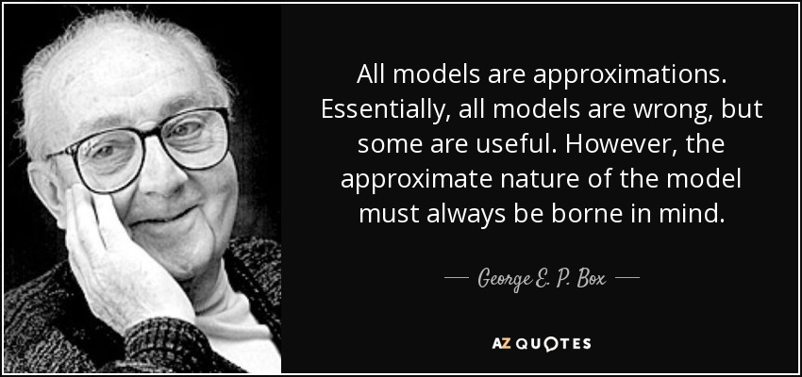
4. Build the Model
Notes:
George E. P. Box (1919–2013) was a British statistician renowned for his influential work in the fields of statistical modeling, quality control, and experimental design. Some key highlights of his legacy include:
1. Pioneering Work in Statistical Quality Control
Box made foundational contributions to industrial statistics and quality improvement, especially through his collaborations with W. Edwards Deming and others in the development of statistical process control techniques.
2. Box-Jenkins Methodology
He co-developed the Box-Jenkins methodology for time series analysis, which remains a cornerstone in forecasting models, especially ARIMA (AutoRegressive Integrated Moving Average) models.
3. Box-Cox Transformation
He co-authored the Box-Cox transformation, a method for transforming non-normal dependent variables into a normal shape, often used in regression and ANOVA.
4. Design of Experiments (DOE)
Box advanced the field of design of experiments, particularly in the context of industrial and scientific settings, emphasizing practical approaches that help engineers and scientists improve processes.
5. Famous Quote
He is often quoted for saying:
“All models are wrong, but some are useful.”
This encapsulates his pragmatic philosophy on the use of statistical models — acknowledging their limitations while emphasizing their value in understanding and improving real-world systems.

Slide 42
4. Build the Model
Machine Learning
Select algorithms
Define model metrics
Optimize hyper-parameters
Create cross-validation training & testing sets
Run & Validate models
Select the best-performing model set
Interpret Model output
Iterate to improve performance
Supervised Learning
Unsupervised
Learning
Reinforcement Learning
Regression
Classification
Clustering
Dimensionality Reduction
Q-Learning
Decision Tree
XGBoost
K-Means
PCA
DQN
Linear Regression
Random Forest
DBSCAN
SVD
SARSA
Logistic Regression
Support Vector Machine
Hierarchical
Discriminant Analysis
Notes:
Supervised learning is a type of algorithm inferring a function from labeled training data. The training data consists of a set of training examples, each with input objects (independent variables) and the desired output object (dependent variable)
Unsupervised learning is a type of algorithm used to draw inferences from datasets consisting of input data without labeled responses – in other words, no dependent variable.
Reinforcement Learning is used in perception, robotics, navigation, gaming and learns by rewarding what the system considers positive behavior and punishing negative. I used a form of reinforcement learning called Hebbian Learning in my Ph.D. research on cooperative vision integration. In this case, different vision modalities like motion, stereo, color could cooperate to reinforce overall vision understanding. It is believed that the brain uses reinforcement learning to form memories by strengthening the electrical signals between synapses. SARSA =State-Action-Reward-State-Action, DQN = Deep Q Network
Classification/Regression – “Supervised Learning“
Linear Regression
Logistic Regression
Decision Trees
Random Forests
Support Vector Machines
Naïve Bayes
Neural Networks
…Implies a “Predictive” Model
Clustering/Segmentation – “Unsupervised Learning“
K-Means Clustering
Hierarchical clustering
Association Rules/Affinity Propagation
Principle Component Analysis

Slide 43
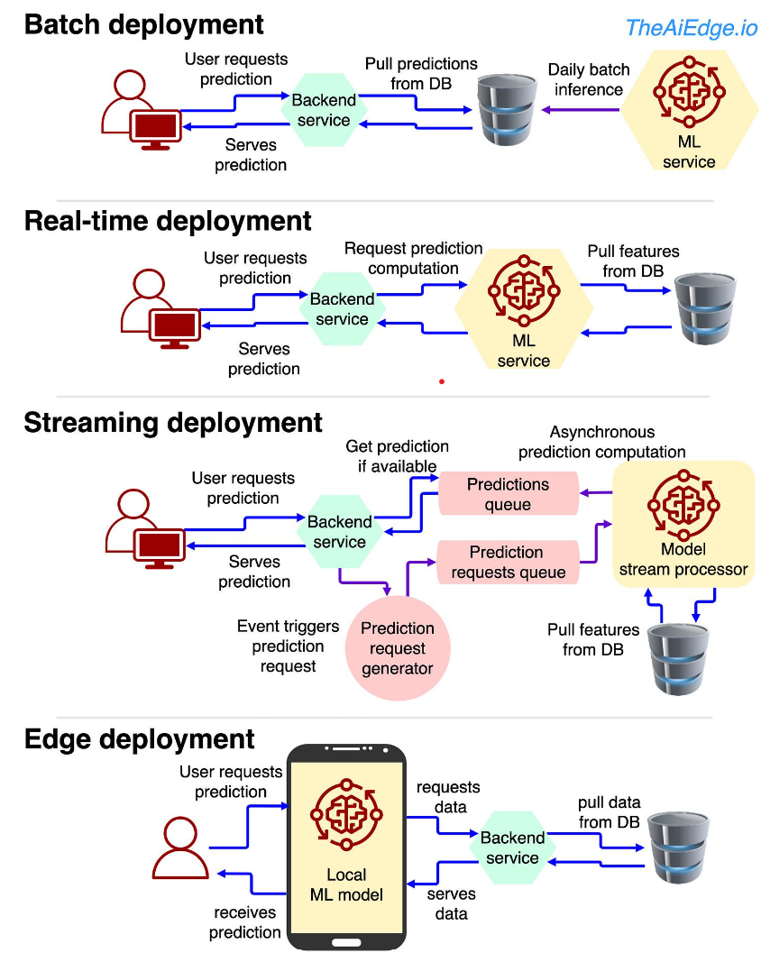
5. Deploy into Production
Deploy
Define requirements
ID business process, tools, & org changes
Determine deployment approach:
Batch Table
REST API Endpoint
Container
Pickle File, PMML, ONYX
Web Service
Stand alone application
Develop app S/W
Integrate with other systems
Prototype
Pilot
Full scale implementation
Deployment Patterns
Lost Opportunity
$$$ lost in opportunity cost for Analytics that are delayed reaching production

Slide 44
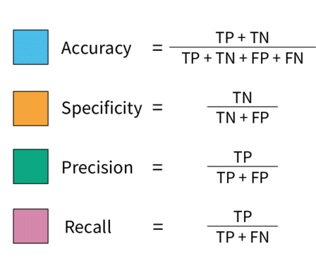
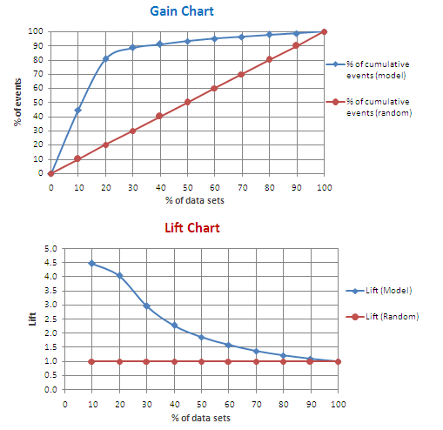
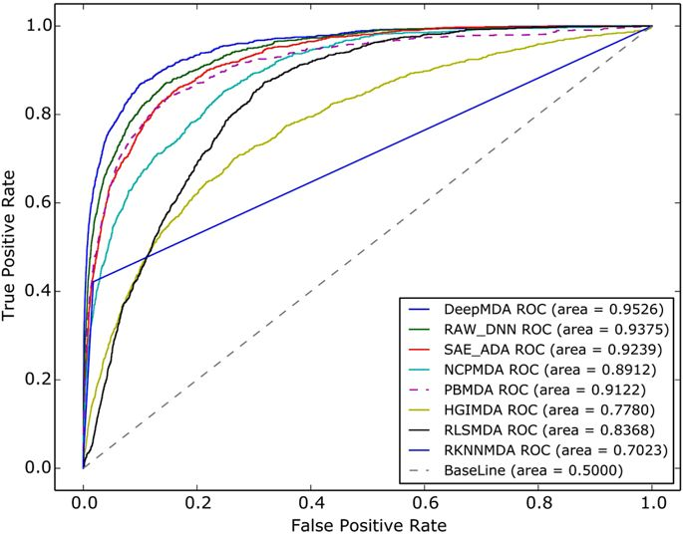
6. Manage and Measure Models in Production
Manage
Model
Repository
Model
Management
Model
Execution
Version Control
Collect data about all model performance
Store model code
Track training and testing sets
Track all model experiments
Trigger retraining when models drift
Run A/B testing
Evaluate model outputs against business goals
Model Metadata
Version Control
Training
Model Scoring Metadata
Automated Testing
Evaluation
Model Store
Release Management
Scoring
Lift Charts
Notes:
As enterprises have matured their DS capabilities, there has been a growing need to address the issues of managing multiple models in production. The Model Management function will be critical for any organization to grow beyond a few models in production.
While I was working at AT&T, we only had a dozen or so models in production at any given time. This is small enough that it can be done manually. However, while working at Teradata, our customers typically had hundreds (Verizon) or thousands of models in production (VW). Other customers were looking to deploy millions. In these cases, it is impossible to manually manage that many models. This is where techniques from MLOps come into play. We'll save that for another time.

Slide 45
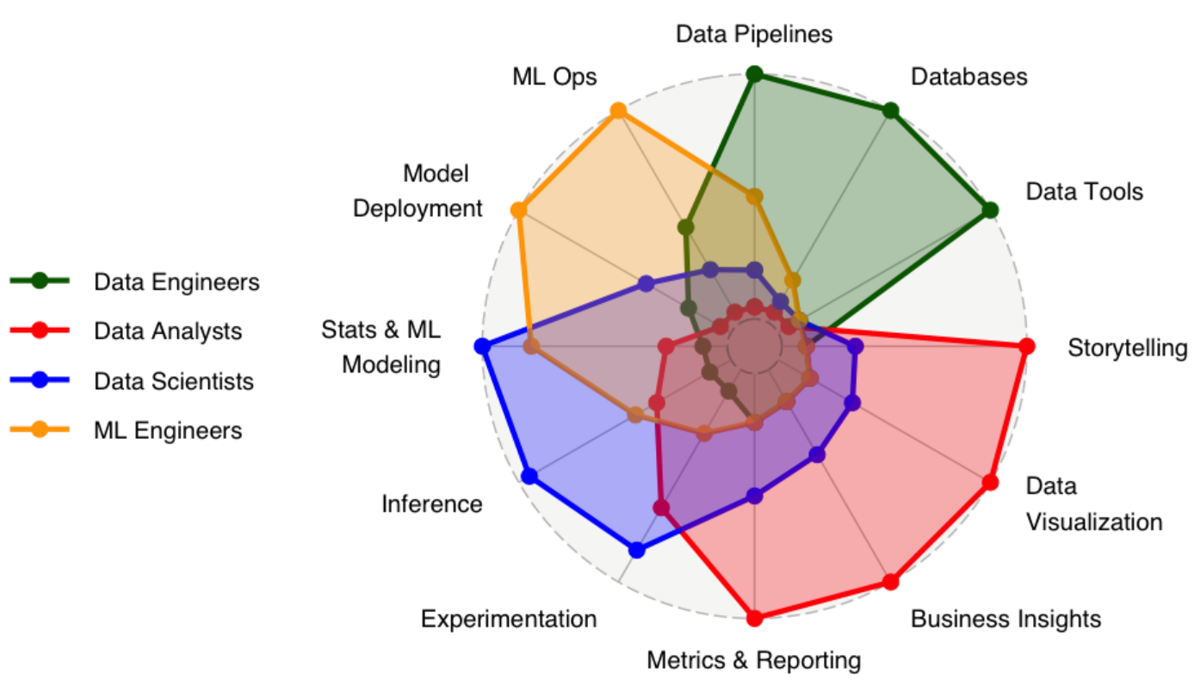
Spider chart of relative skills for key data roles
From https://www.datacaptains.com/blog/guide-to-data-roles

Slide 46
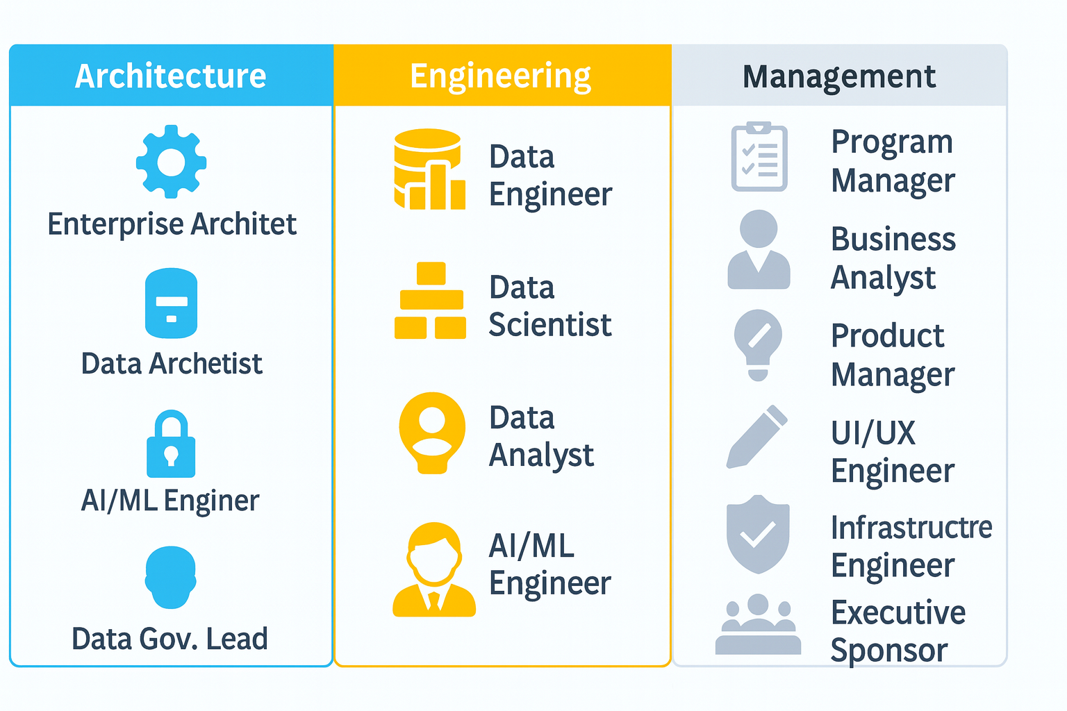
Roles on a Data Science Application Project
Notes:
I generated this list by reflecting on the last project I did with Nu Skin. In this case, every single one of these roles was touched at some point in the project.

Slide 47
Extended Roles on a Data Science Application Project
Role | Description
Data Engineer | Builds data pipelines, joins tables, converts data formats, prepares data for use by Data Scientists.
Data Scientist | Prepares data for modeling, extracts features, builds models
Data Analyst | Expert in SQL, BI, Excel, Analyzing data but not necessarily a domain expert (Tableau, PowerBI most popular tools)
AI/ML Engineer | Builds ML pipeline, integrate enterprise systems, monitor & manage models, skilled software engineer & data scientist
Enterprise Architect | Integrates DS applications into enterprise system (e.g., microservices, API gateway, event brokers, etc.)
Data Architect | Defines data management system architecture, data model
Data Governance Lead | Responsible for meta data, data catalog, data access, change management policies
Business Analyst | Expert in a particular domain (e.g., Finance), can use BI tools and Excel if set-up by the Data Analyst.
Program Manager | Keeps track of projects, personnel, budgets, identifies conflicts, dependencies, resource constraints
Application Engineer | Expert in technology for a particular domain or problem (e.g., Finance, Marketing, Sales, Manufacturing, etc.)
UI/UX Engineer | Designs, prototypes, and builds the user interface (mobile and web)
Product Manager | Responsible for overall product design, prioritization, deployment and assuring business value
Infrastructure Engineer | Expert in cloud and data management infrastructure
Security/Privacy Engineer | Assures application architecture is compliant with Enterprise security and privacy standards
Executive Sponsor | Oversees application development. Responsible for resourcing. Communicates with Executive Leadership.
Notes:
I generated this list by reflecting on the last project I did with Nu Skin. In this case, every single one of these roles was touched at some point in the project.

Slide 48
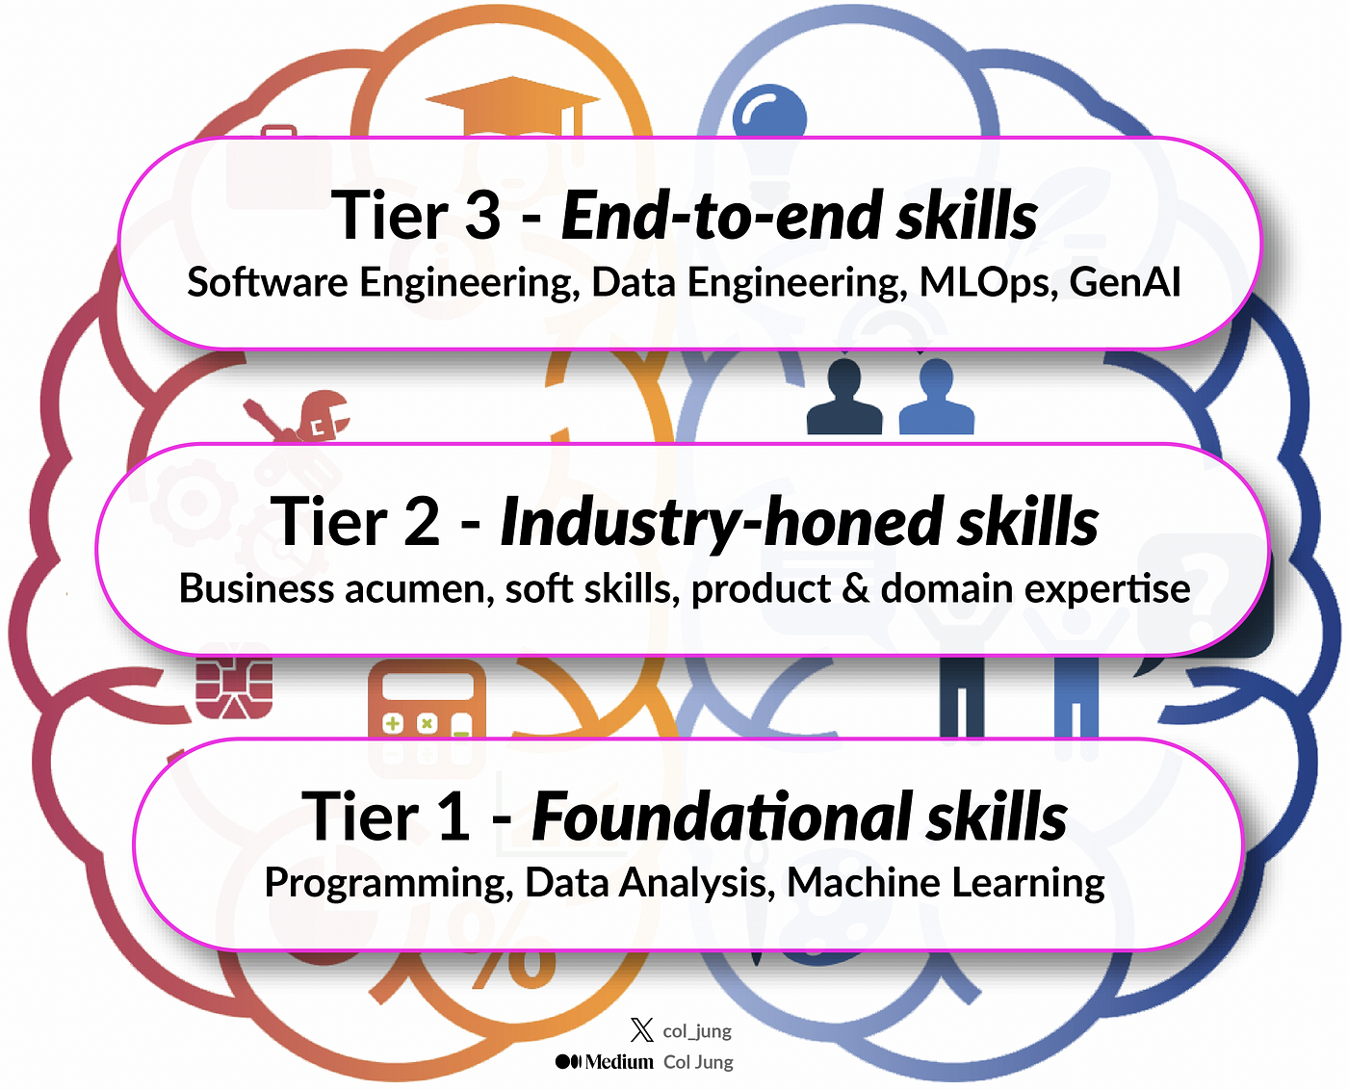
Skill Sets for Full Stack Data Scientists
“Evolution of Data Science: New Age Skills for the Modern End-to-End Data Scientist,” by Col Jung, Medium, July 23, 2024.

Slide 49
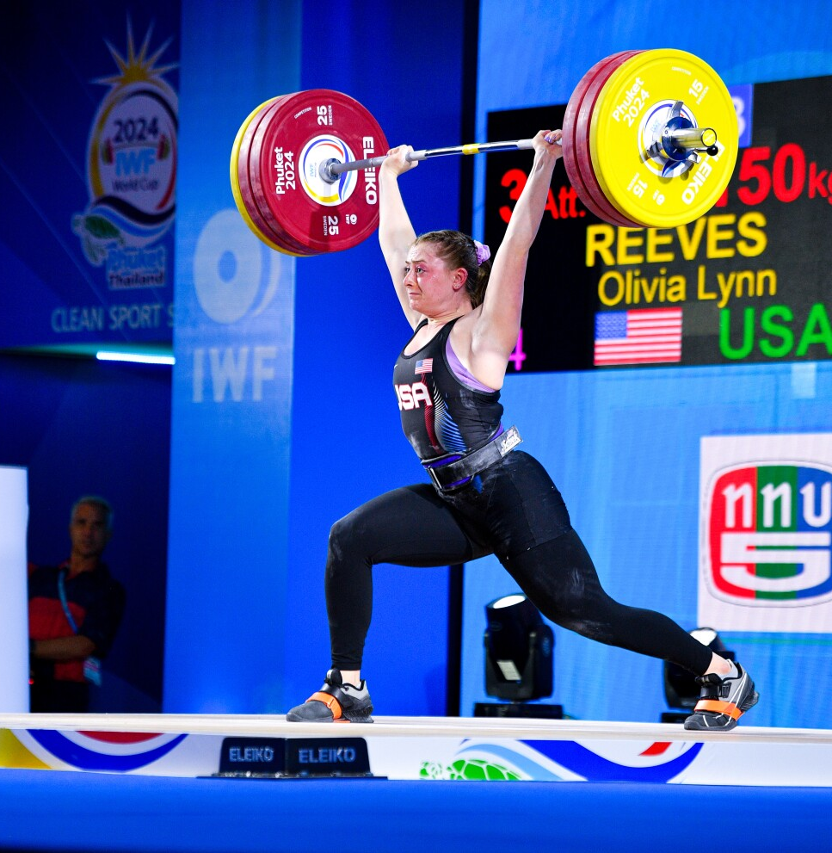
Upcoming Assignments
Data
Data
Sign up for zyBook. How? Go to the first reading assignment in Canvas and click “Load Chapter 1 Reading…” This will initiate the process of buying the zyBook. You should not have to do this again.
Reading Assignment: Chapter 1. Points automatically accrue as you do the activities in the book.
Data Science Lab 1: Intro to Colab. Set up a Python Development Environment. Programming assignments will be turned in via Google Colab notebooks. However, if you are planning a career requiring programming, I recommend using a professional IDE, such as VS Code. If needed, we’ll go through the setup quickly next week.

Slide 50
We have just one job…

Slide 51
BYU’s role is to build Christ-like leaders
What did Christ do?
Heal the Sick → Improve Health Outcomes
Feed the Hungry → Reduce Scarcity and Waste
Raise the Marginalized → Expand Access and Inclusion
Defend the Vulnerable → Protect Against Exploitation
Calm Chaos → Reduce Risk and Instability
Heal Without Judgment → Deliver Help Without Stigma
Cross Boundaries → Integrate Disconnected Systems
Expose Hypocrisy → Reveal Truth in Systems
Empower Others → Democratize Insight and Tools
Reject Coercive Power → Build Non-Manipulative Systems
Judge by Fruit → Measure Real-World Impact
Serve Quietly → Prioritize Outcomes Over Recognition

Slide 52

Marissa Fayer, Deeplook Medical
5% of breast cancer tests are still false negatives

Slide 53

Taylor Sheed, Stemuli
Improving inner-city education outcomes with AI-driven video games

Slide 54
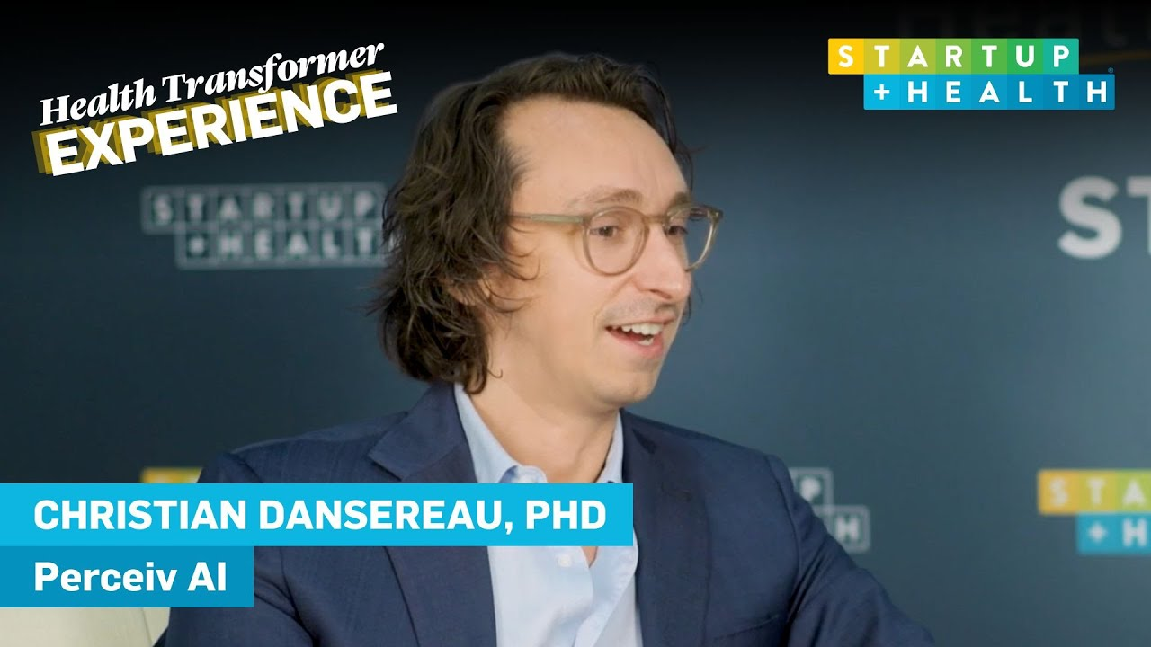
Solving Alzheimers through early prediction

Slide 55
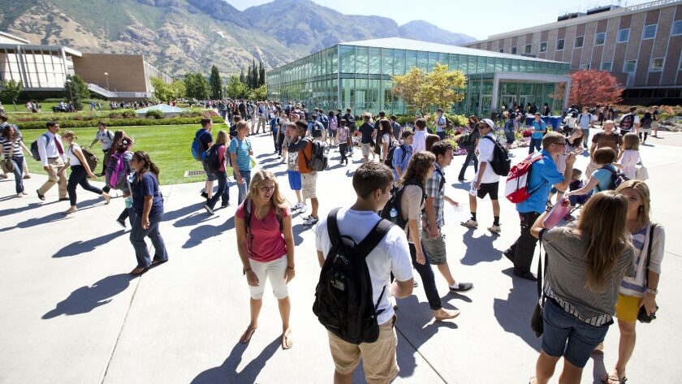
And you…

